Slide 1




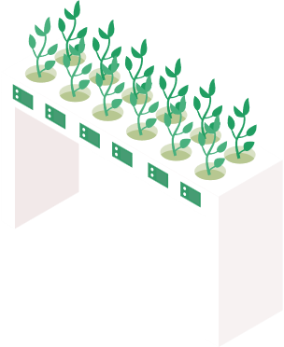

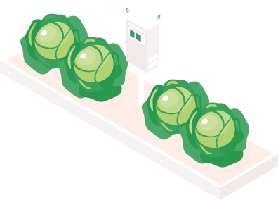
SMARTAGRI
DolphinGroup
Project presentation

Slide 2

task 1
task 2
task 3
task 4
task 5
Executive summary
Problem
The use of technology in agriculture is on the rise.
Ineffective and synchronous yields
Weak interconnection of agribusiness
Target audience
Gender: All gender
Age: Gen X – Gen Z
Hobbies: Agriculture, Investment.
Solution
A hybrid-app can:
+ Connects parties in Agribusiness
+ Update high-tech agricultural news
+ Find investors
Highlights
Investment feature
E-com service
Sharing knowledge forum
Gains & lessons
Experience to work in a short project

Slide 3
Agenda
Project Implementation
Project Timeframe
Final product
Self-assessment
Problem, solution & goal
Brainstorming report
Task management Accomplishment
Features
Technical stack
Potential
Quality of works
Level of success of the project
Takeaway experience

Slide 4



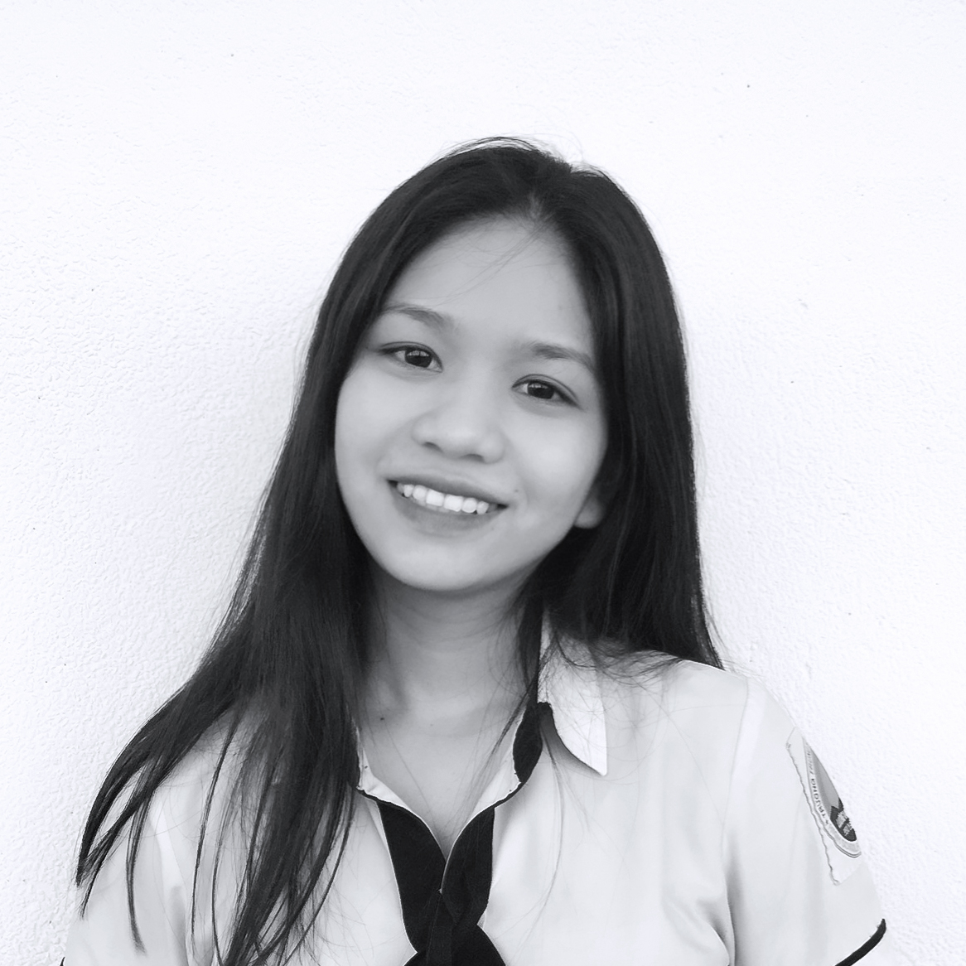

Personnel
Dang Loc Project Manager
Phuoc Tung Product Manager
Vi Khang Technical Architecturer
Thu Trang ​BA, Financial Manager
Thanh Hai Tester

Slide 5
Problem
Project implementation
Lack of high
technology applications
Weak connection between customers, farmers and companies
Product yields are not effective and synchronous

Slide 6
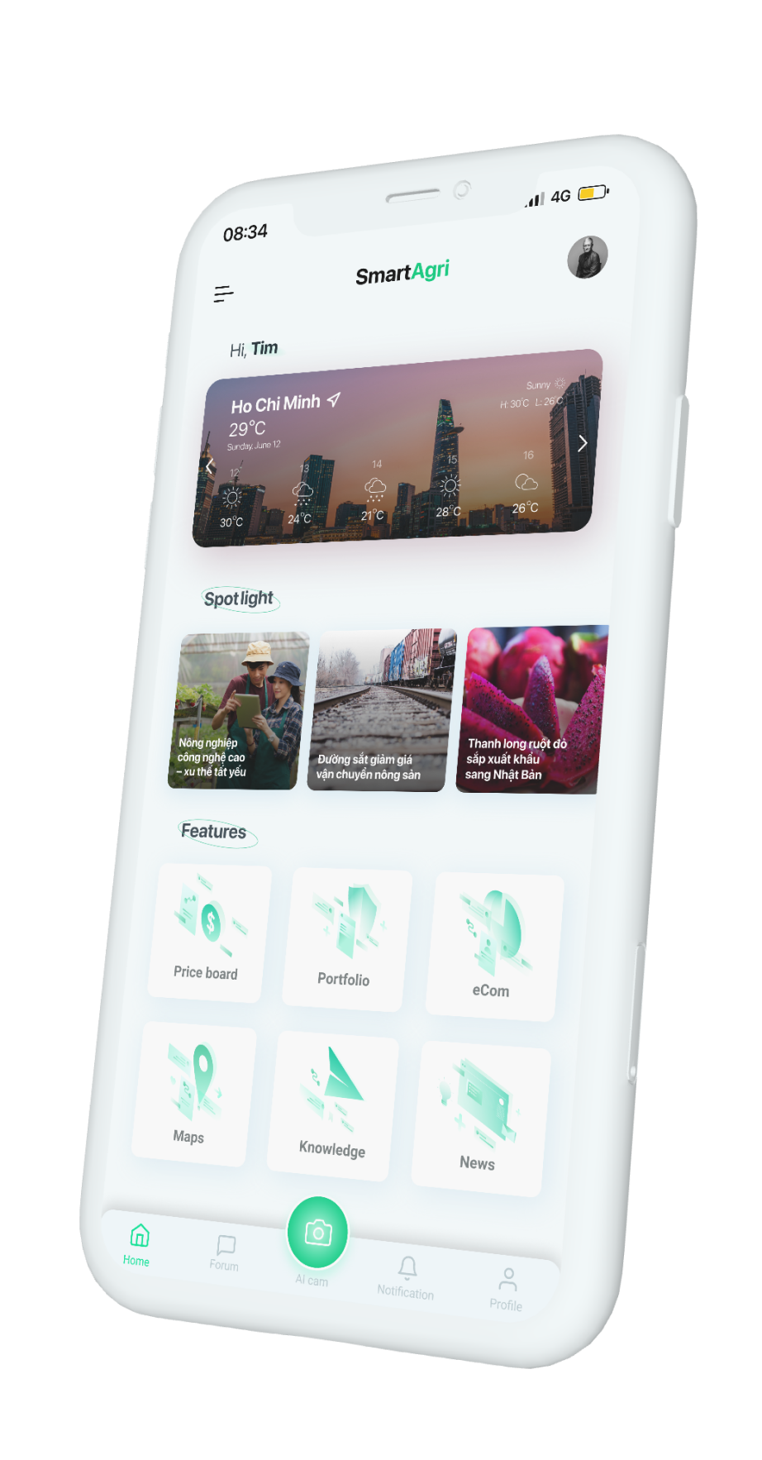



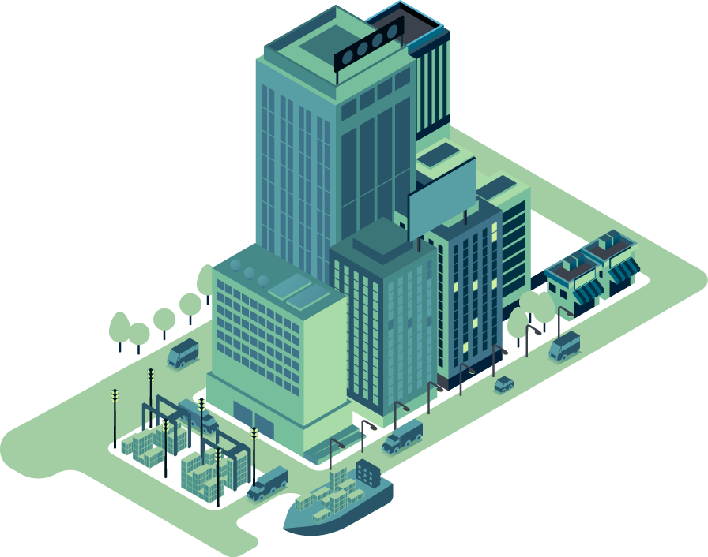

Idea
Project implementation
Connects parties
in Agribusiness
Update high-tech agricultural news
Find investors

Slide 7
Goals
Project scope
1 Optimize productivity and yields.
2 Low prices smart app
3 Synchronizing products.
4 Real-time interaction, high accuracy

Slide 8

Research report
Brainstorming stage
Market need
Agriculture is becoming more technologically advanced
Creating and growing agricultural industries in using high-tech
SWOT analysis
Strengths | Weakness
Agricultural is the key economic sector of Viet Nam. Many tools for data collection, analysis, and statistics. | The need for supply chain partners. High-tech farm can be prey expensive.
Oppounities | Threats
The government promotes technology in agriculture. People tend to buy clean, safe products from food chains. | A diverse range of plants, it is challenging to cover Agriculture's Aging Population Data-theft with consumers and suppliers.
“Make a basic platform but still meet the requirements & the needs of users”

Slide 9




Planning
Brainstorming stage
Target Customer
Gender: All gender
Age: Gen X – Gen Z
Hobbies: Agriculture, Investment.
The farmers
The youngsters
The merchants
Profit model
Cost of IPO
Investment
Cost per exchange
Commission from customer
E-Com
Listed on the market pre-money
Competitors
Delivery
Forum

Slide 10








Finance
Manage working process
Free
Storing data, files, information
Free
Communication
Free
Conduct meeting
Free
UI/UX design
Free
Reference resources, data researching
Free

Slide 11
Project timeline
Milestone | Description | Assignee | Begin Date | Target End Date | Completed Date
Phase 1: Kick-start | Research, strategize & plan; Develop ideas | All members | 05/11/2021 | 05/12/2021 | 05/12/2021
 | Assumption of risk | Tùng, Khang, Trang | 05/11/2021 | 05/12/2021 | 05/12/2021
 | Project introduction | All members | 05/11/2021 | 05/12/2021 | 05/12/2021
 | Project proposal | All members | 05/13/2021 | 05/19/2021 | 05/19/2021

Slide 12
Project timeline
Milestone | Description | Assignee | Begin Date | Target End Date | Completed Date
Phase 2: Run-up | Industry, Market & Business research | All member | 05/25/2021 | 06/06/2021 | 06/12/2021
 | App feature description | Tùng | 06/13/2021 | 06/23/2021 | 06/20/2021
 | Contents | Khang, Trang, Hải | 06/22/2021 | 06/27/2021 | 06/26/2021
 | Target audience | Trang, Hải | 06/22/2021 | 06/25/2021 | 06/25/2021
 | Technical design | Khang | 06/27/2021 | 07/17/2021 | 07/13/2021
 | Visualization UI/UX design & app prototype | Lộc, Tùng | 06/27/2021 | 07/18/2021 | 07/19/2021

Slide 13
Project timeline
Milestone | Description | Assignee | Begin Date | Target End Date | Completed Date
Phase 3: Closure | Completing paperwork, documentations | Lộc, Tùng, Khang | 07/10/2021 | 07/20/2021 | 07/20/2021
 | Self-assessment of project | Lộc, Trang | 07/11/2021 | 07/18/2021 | 07/17/2021
 | Takeaway experiences | All members | 07/18/2021 | 07/21/2021 | 07/20/2021

Slide 14

Accomplishment
Successfully developed agricultural e-com with synchronized quality, price, and product source.
Created a platform that connects components in the Agribusiness ecosystem to motivate delivering farm produce, and optimize supply chain.
Expanded the agricultural knowledge-sharing community, follow high-tech agricultural tendencies.

Slide 15
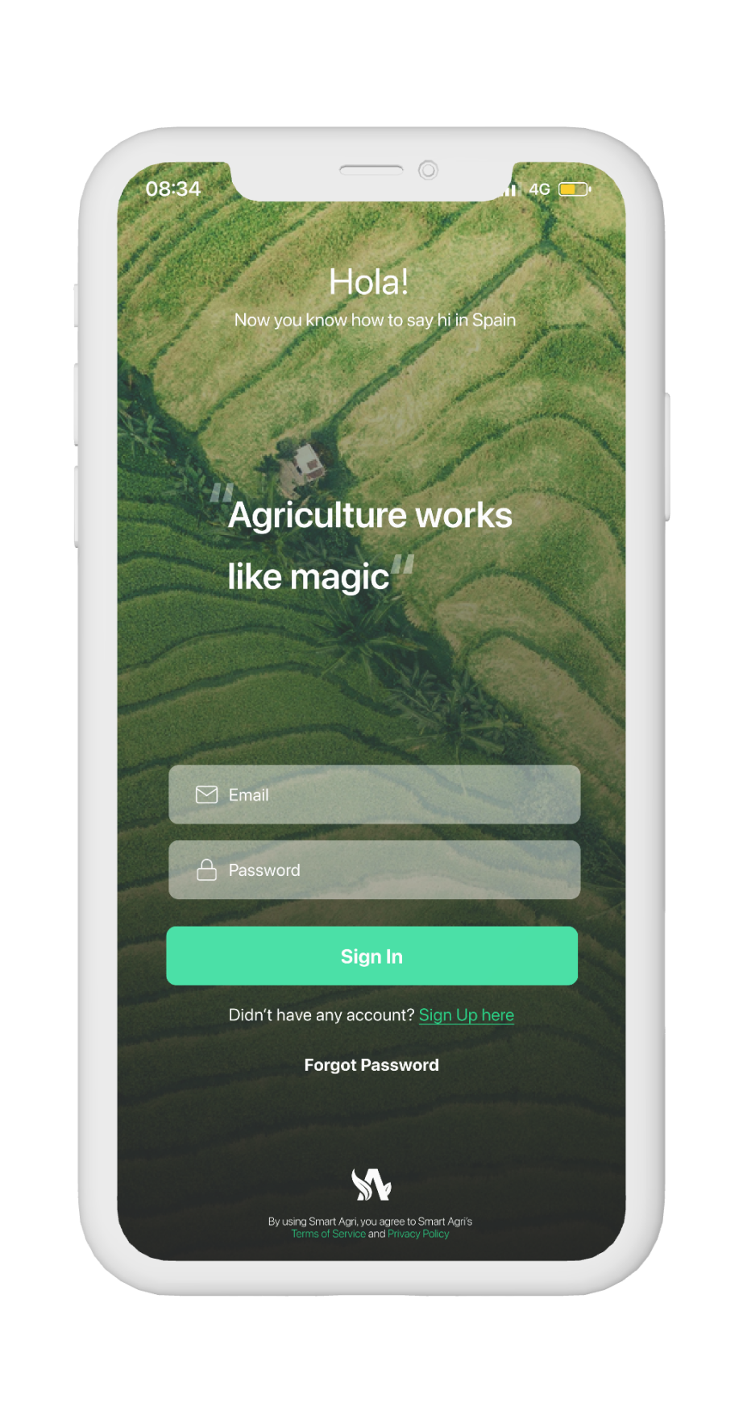
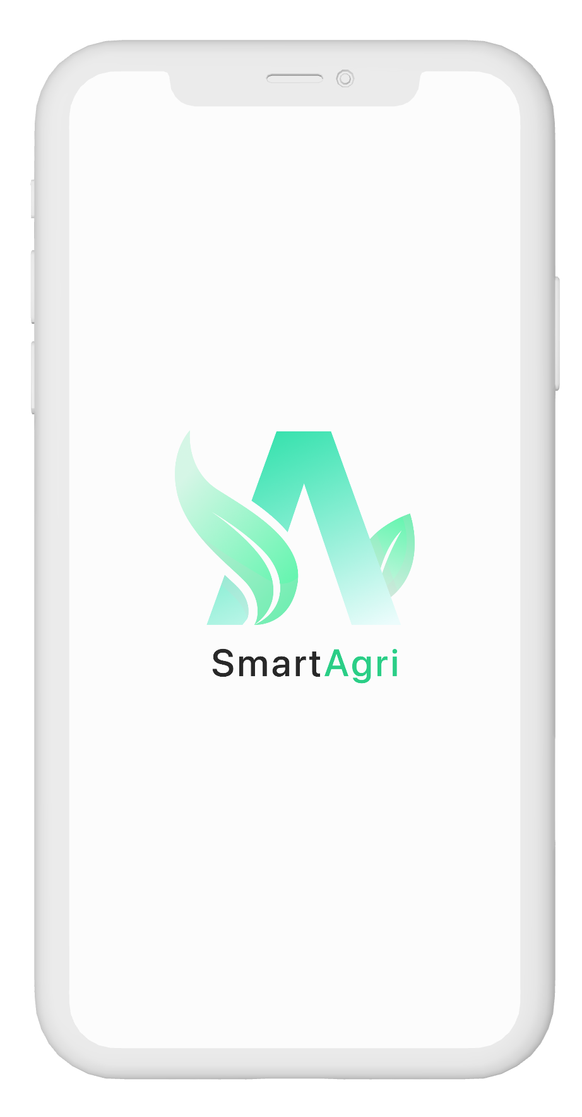
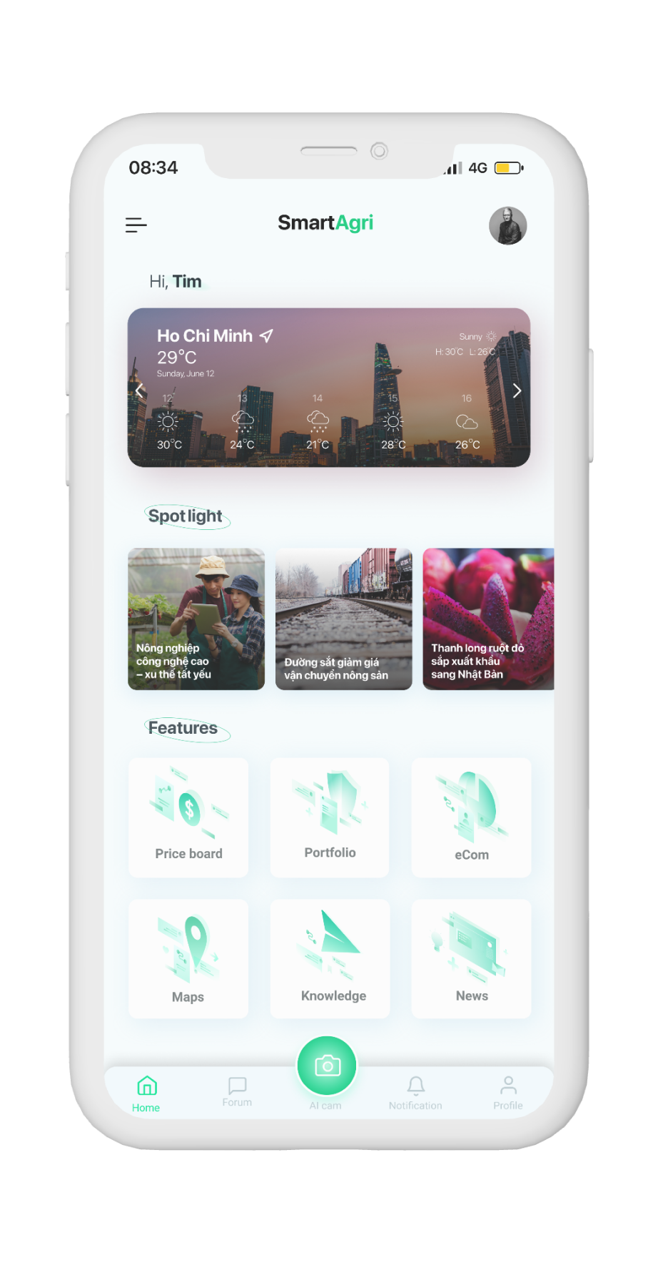
Introduction
Final product
SmartAgri
Offers these services:
Online Grocery delivery
Farm investment service
News
Farms map
Knowledge

Slide 16
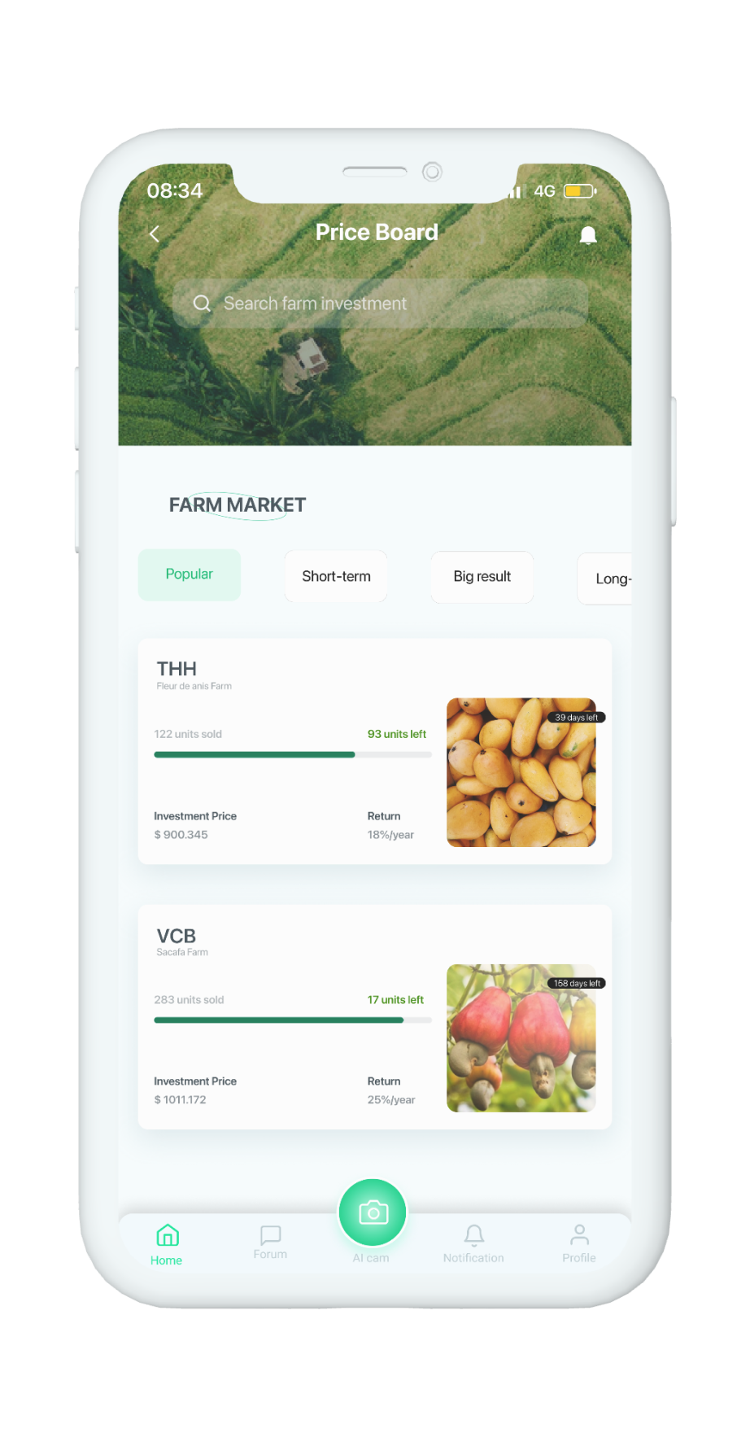
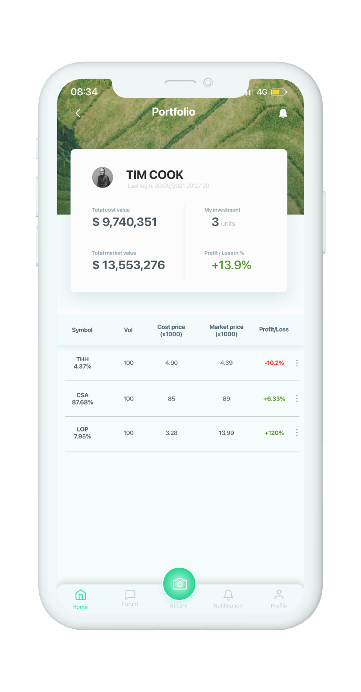
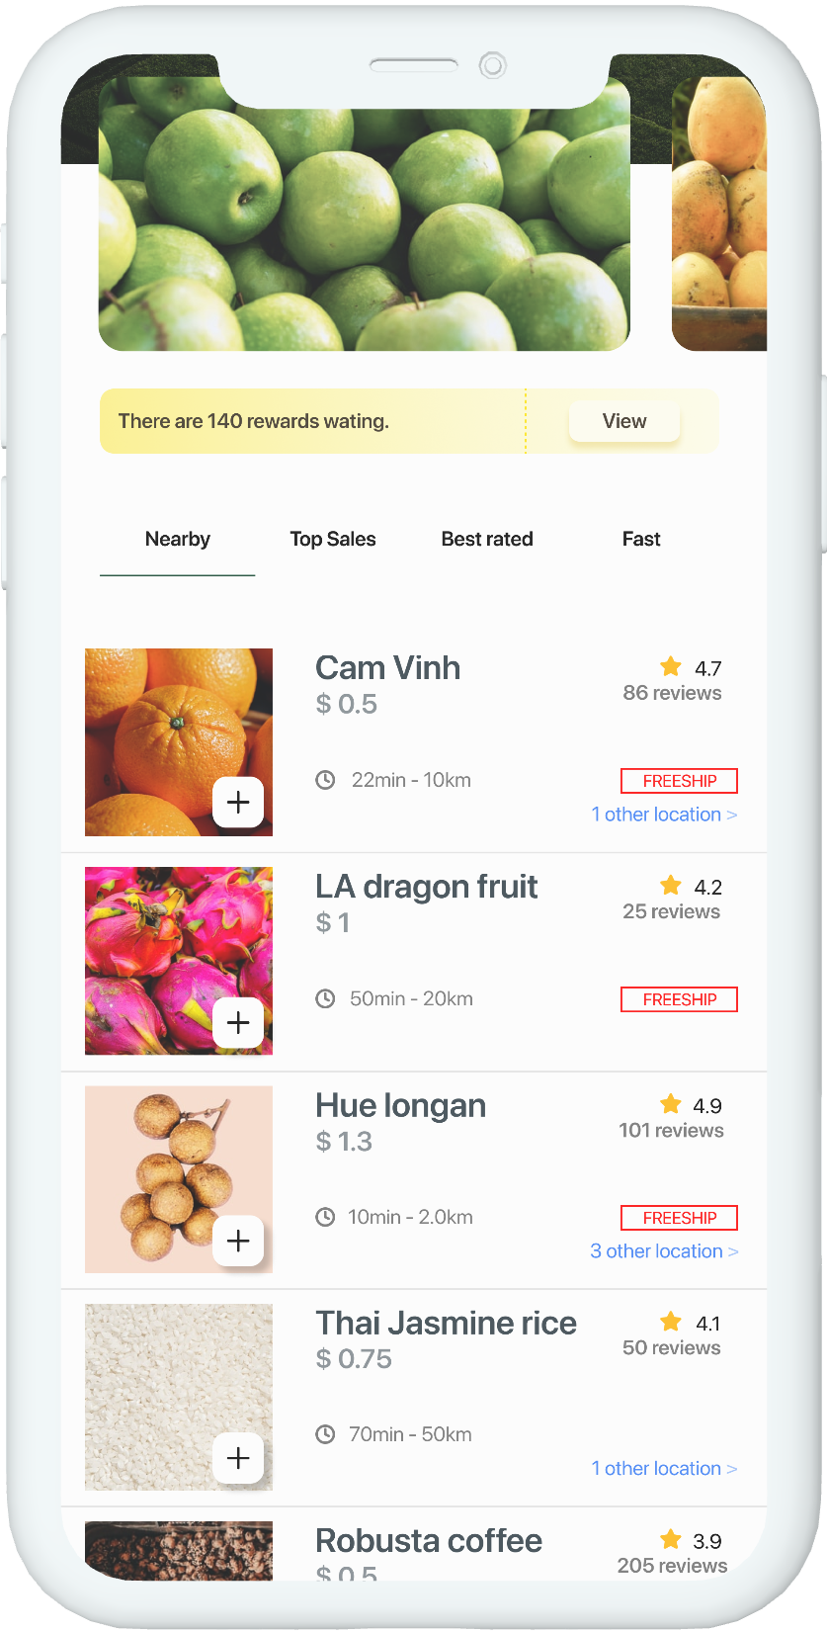
Features
SmartAgri
Final product
Priceboard
Portfolio
eCom

Slide 17
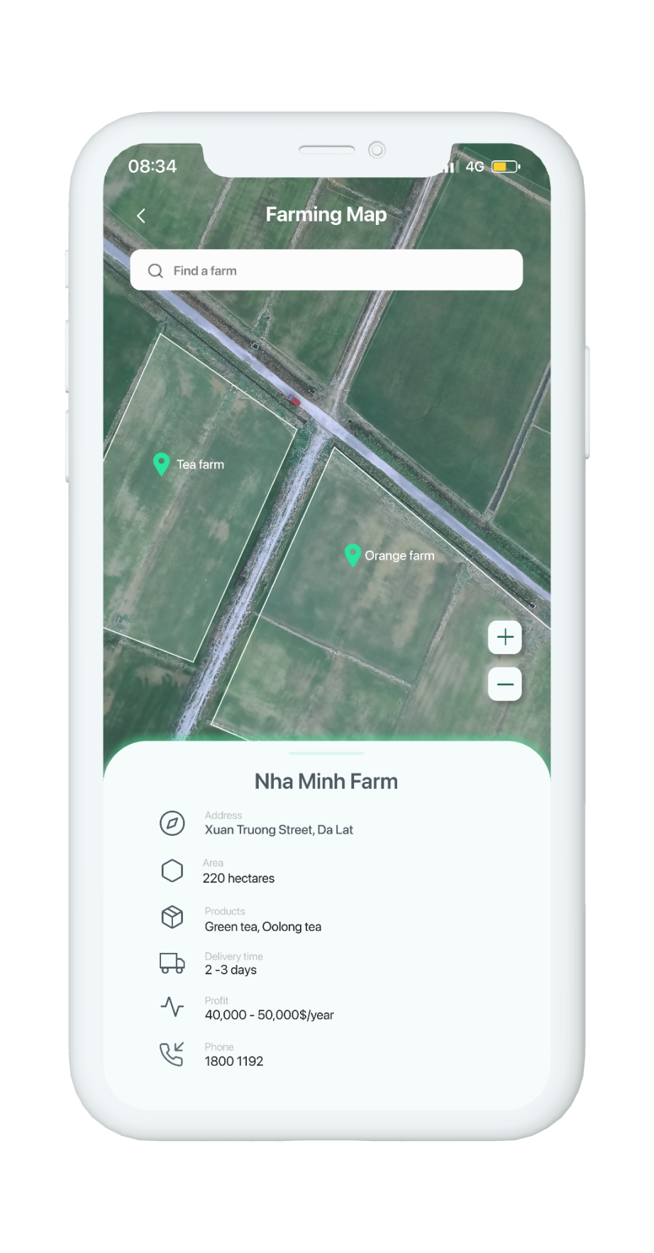
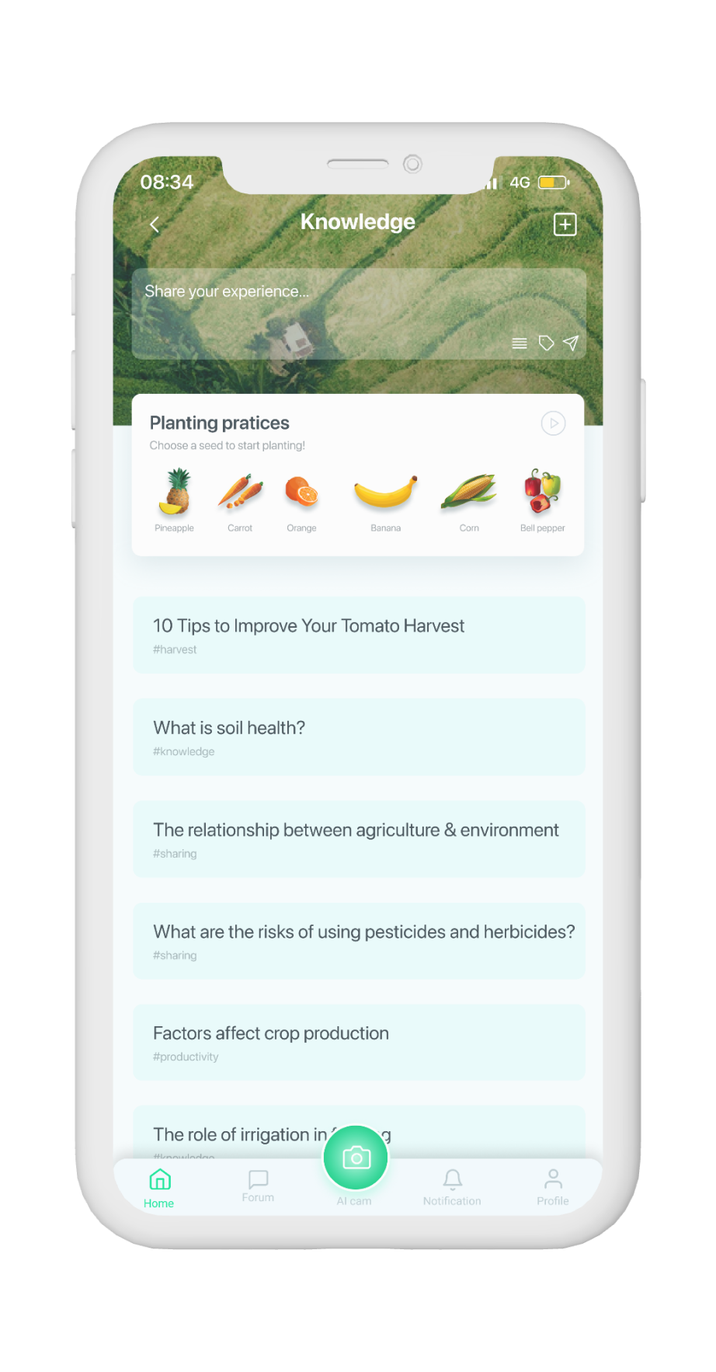
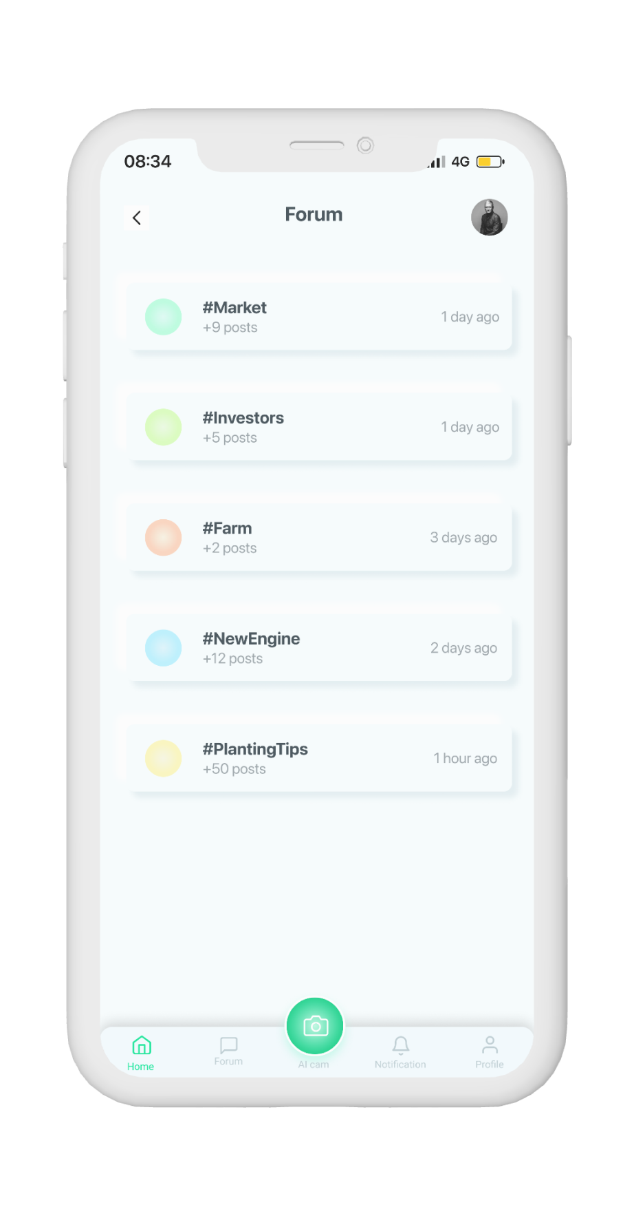
Features
SmartAgri
Final product
Farm Map
Knowledge
Sharing forum

Slide 18







Technical stack
Final product
Operating system
Servers
Databases; Authentication; Hosting
Front-end frameworks (user interface)
Data analytic platform
AI services
Versions control

Slide 19

Risk
Misunderstand use of features
Smart Agri lacks actual data.
Challenging UX design for different types of users

Slide 20
Potential
IoT applications
Sensors, drones or weather indicators, .etc
AI intergrated
Recognizing plants through pictures
Real-time contact
Tracking the growing state of the plants
Bigdata applications
Analyzing database suggestions between investors and farm owners

Slide 21
Self-assessment
Project
Manpower
Product
Task management
95%
Communication
70%
We achieved our main goals proposed before
Task complete on time
Not really effective
Adjustments in working
Analysis
80%
The limitations of project was unclear at first, after some meeting and conversation, we found the same voice.
Work sharing
Leadership
Shared equally
Good, work effectively
Design
Members help the others complete tasks
Detailed and creative
Problem solving
70%
Implementation
Everyone is supportive and ready to help the others
Following the design but flexible
Evaluation
Successfully implemented basic features
Basic and modern UI
Pay attention to UX and security when launched

Slide 22
Gains & lessons
Self-assessment
Summarize the group's tasks and processes, clarify the team's strengths and weaknesses
Learn more about Vietnam's agricultural market and the applications of technology in agriculture
Know how to work on a large process broken down into small & specic phases
Learn how to use technology platforms, applications to create products
Have a broader view of many other aspects when making a product
(market demand, customer psychology, implementation costs, ...)

Slide 23
about the project
jupiter
Jupiter is the biggest planet in our Solar System
mercury
Mercury is the smallest planet in our Solar System
saturn
Saturn is composed mostly of hydrogen and helium
venus
Venus has a beautiful name, but it’s terribly hot

Slide 24
“This is a quote. Words full of wisdom that someone important said and can make the reader get inspired.”
—SOMEONE FAMOUS

Slide 25
project schedule
Task 1
December
Despite being red, Mars is a cold place, not hot
Task 2
January
Mercury is the smallest planet in our Solar System
Task 3
March
Jupiter is the biggest planet in our Solar System
Task 4
May
Saturn is composed mostly of hydrogen and helium
Task 5
July
Neptune is the farthest planet from the Sun

Slide 26
checklist
Here you can describe the state of your task 1
Here you can describe the state of your task 2
Here you can describe the state of your task 3
Here you can describe the state of your task 4
Here you can describe the state of your task 5

Slide 27
project timeline
PHASE 1 Venus has a beautiful name, but it’s terribly hot
PHASE 2 Despite being red, Mars is a cold place, not hot
PHASE 3 Mercury is the closest planet to the Sun
PHASE 4 Jupiter is a gas giant and the biggest planet in our Solar System

Slide 28
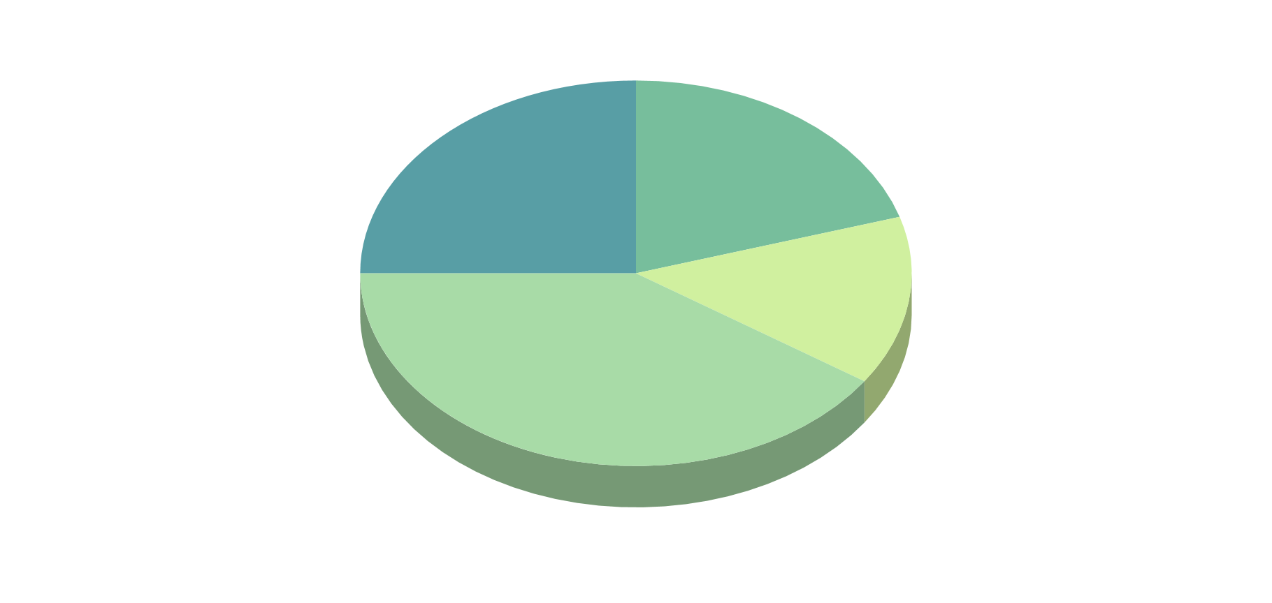
kpi dashboard
BUDGET
90%
80%
Mars
Venus
40%
EVOLUTION
Mercury
Jupiter
If you want to modify this graph, click on it, follow the link, change the data and replace it
DATA
40M
12
70M
Revenue
Awards won
Users
Venus
Mars
Mercury

Slide 29
status report

Slide 30
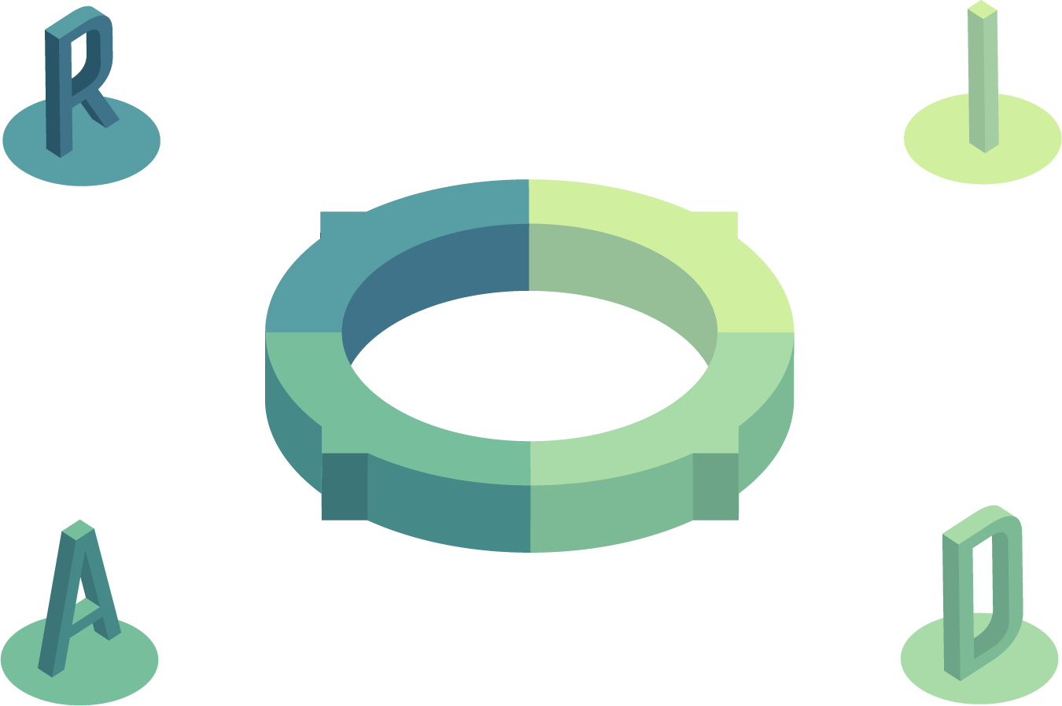
raid summary
RISKS
ISSUES
Neptune is the farthest planet from the Sun and the fourth-largest in our Solar System
Mercury is the closest planet to the Sun and also the smallest one in our Solar System
ASSUMPTIONS
DEPENDENCIES
Despite being red, Mars is a cold place, not hot. It’s full of iron oxide dust, giving the planet its reddish cast
Jupiter is the biggest planet in our Solar System and the fourth-brightest object in the sky

Slide 31


where we are
where we want to be
Mercury is the closest planet to the Sun and the smallest one in our Solar System—it’s only a bit larger than our Moon. The planet’s name has nothing to do with the liquid metal since it was named after the Roman messenger god
Venus has a beautiful name and is the second planet from the Sun. It’s terribly hot—even hotter than Mercury—and its atmosphere is extremely poisonous. It’s the second-brightest natural object in the night sky after the Moon

Slide 32
upcoming events
MERCURY
FEB 27
VENUS
MAY 13
MARS
JUN 10
Mercury is the closest planet to the Sun and the smallest one in our Solar System—it’s only a bit larger than our Moon
Venus has a beautiful name and is the second planet from the Sun. It’s terribly hot, even hotter than Mercury
Despite being red, Mars is a cold place, not hot. It’s full of iron oxide dust, which gives the planet its reddish cast

Slide 33
THANK YOU!
If you have any questions?
Don’t hesitate to ask us
or contact us
dolphin.team111@gmail.com
DolphinGroup

Slide 34

credits
This is where you give credit to the ones who are part of this project.
Presentation template by Slidesgo
Icons by Flaticon
Infographics by Freepik
Author introduction slide photo created by Freepik
Text & Image slide photo created by Freepik.com

Slide 35
#589ea5
#77be9c
#a8dba7
#d0f09f

